Slide 1



International System Change Compass
Global implications of achieving the European Green Deal
Date

Slide 2
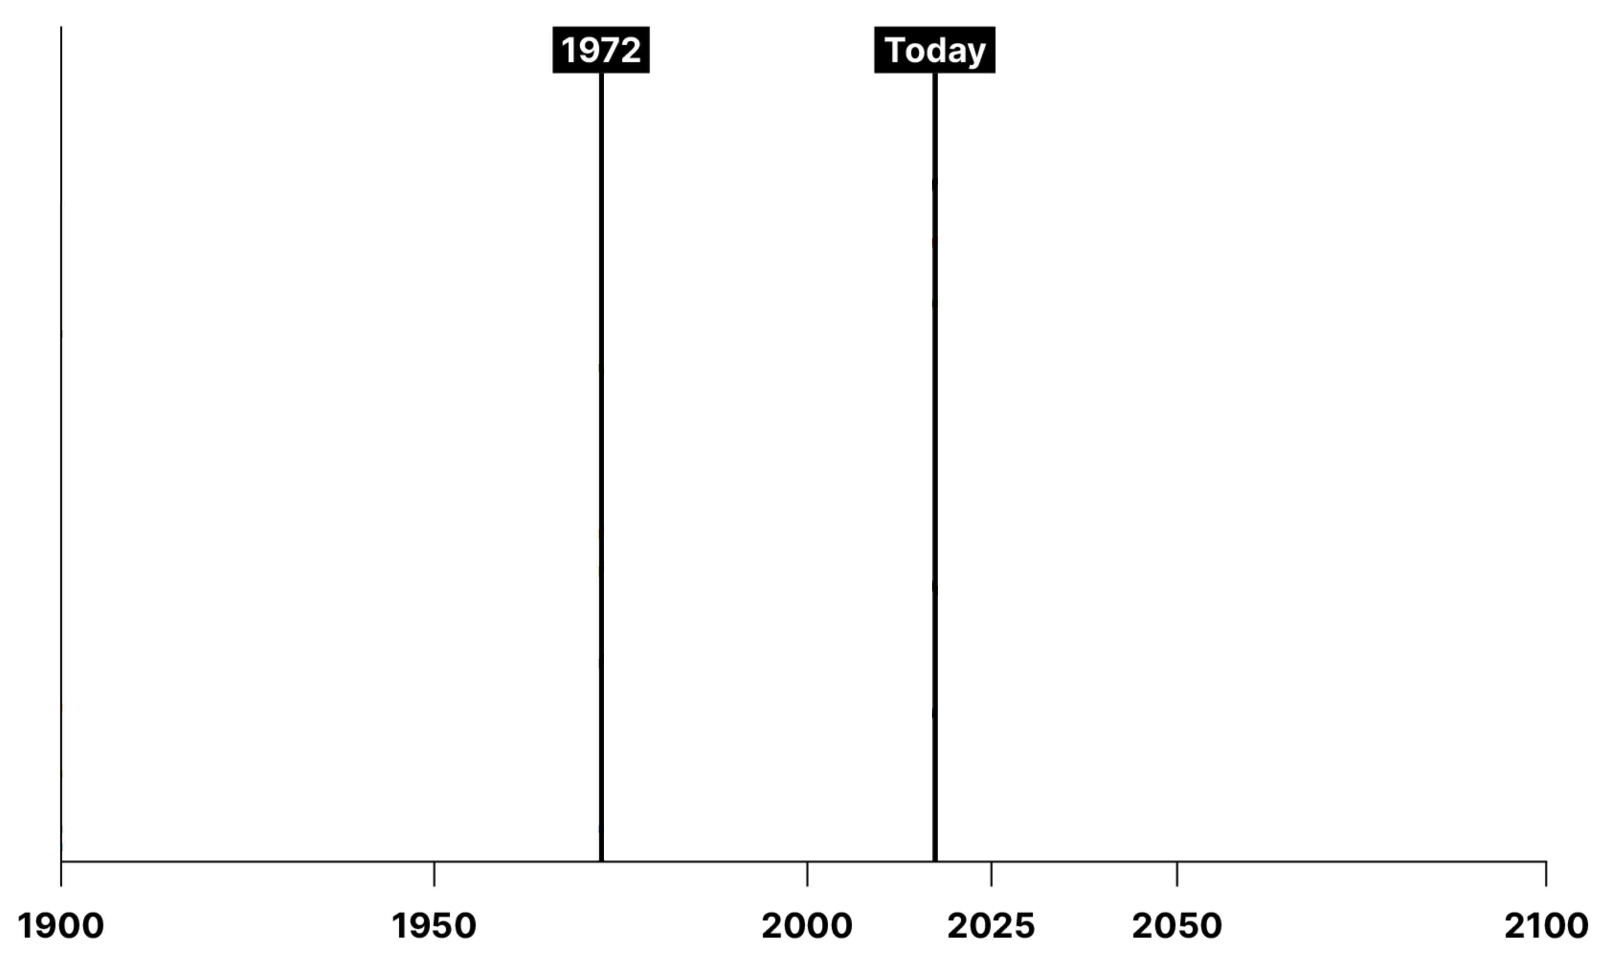
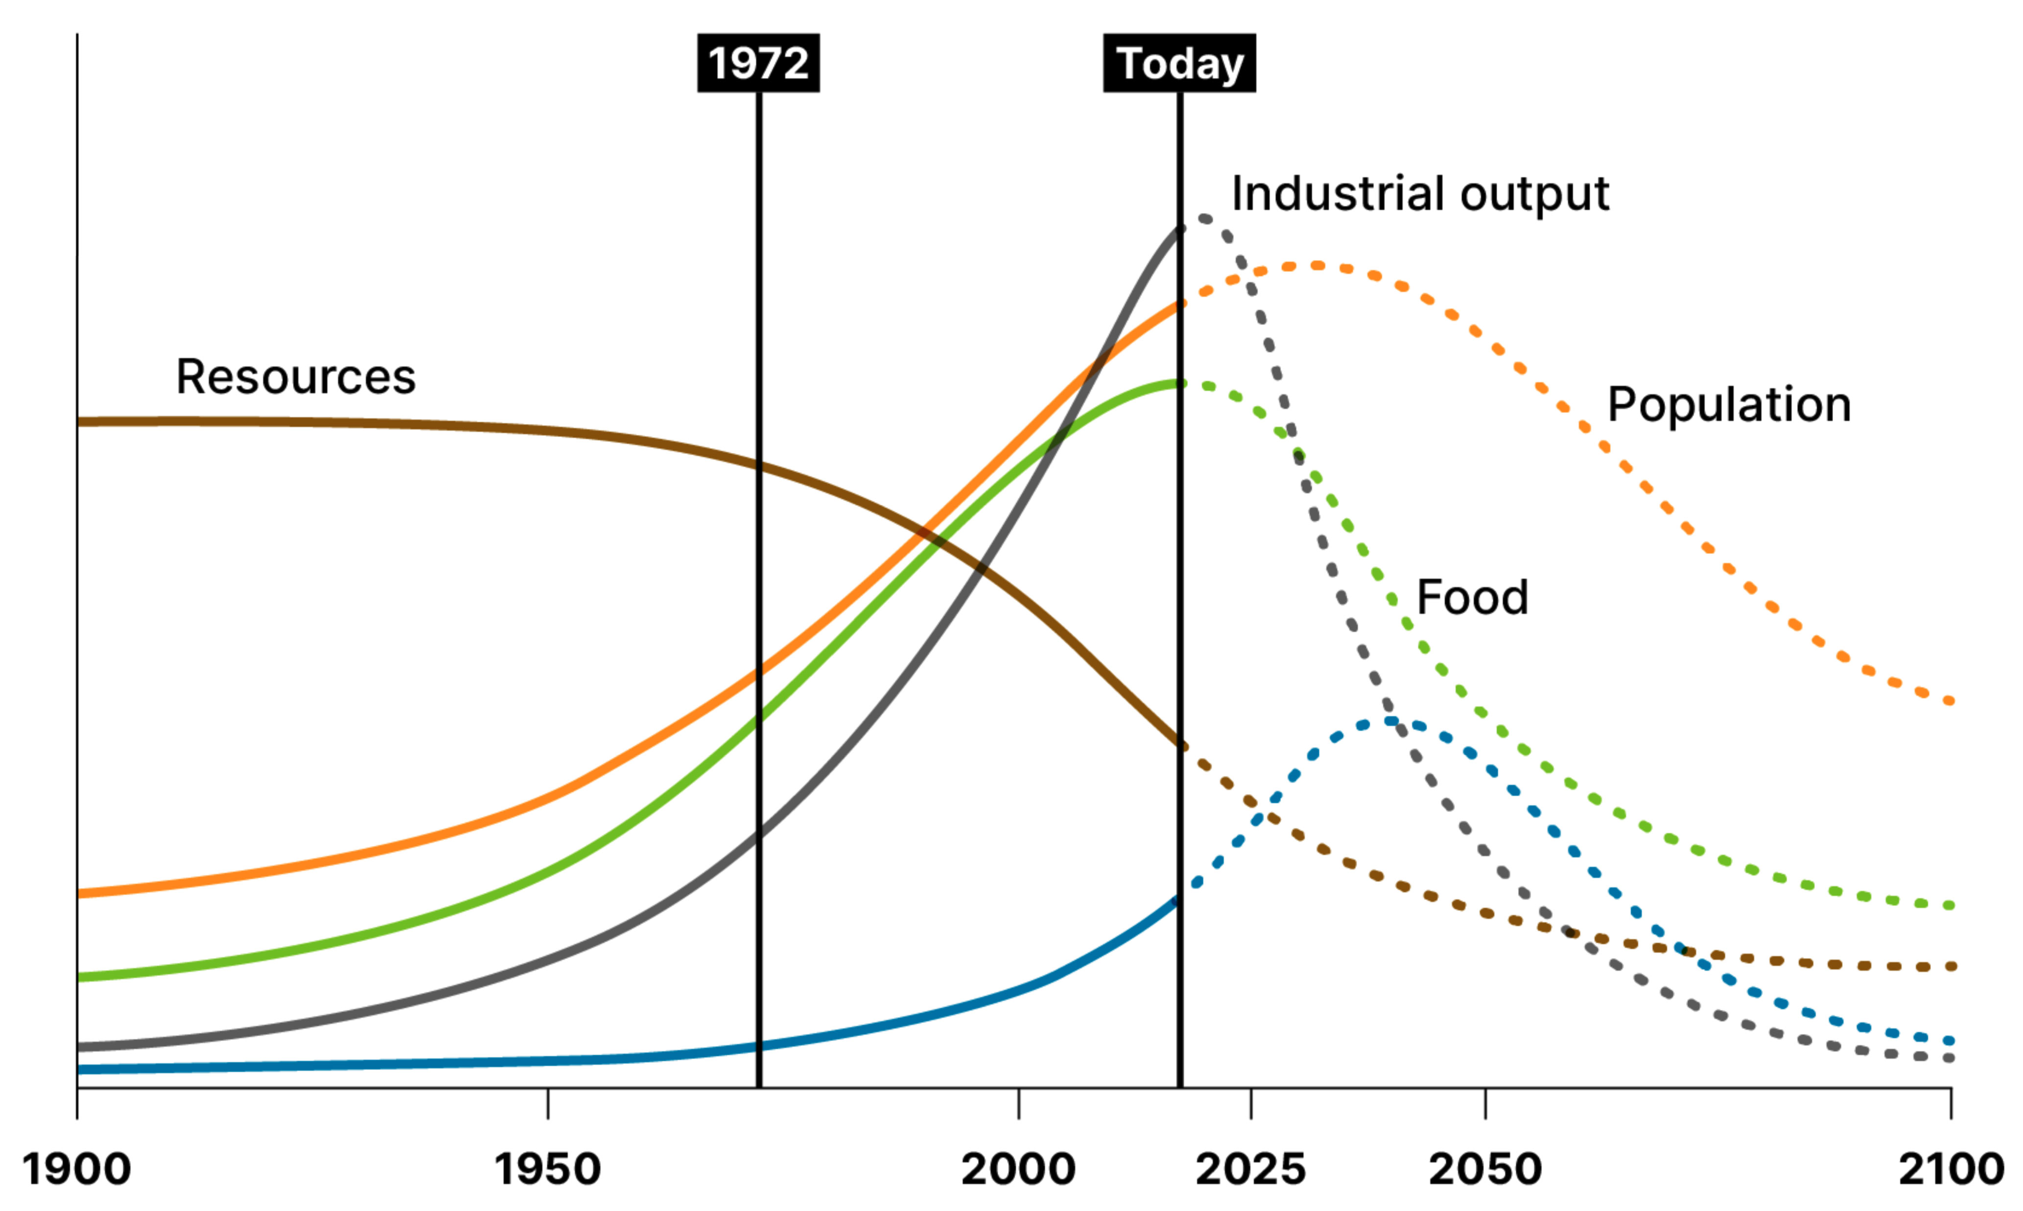

We are risking collapse
“This supreme effort is a
challenge for our generation.
It cannot be passed on to the next. The effort must be resolutely undertaken without delay, and significant redirection must be achieved during this decade.”
The Limits to Growth
1972

Slide 3
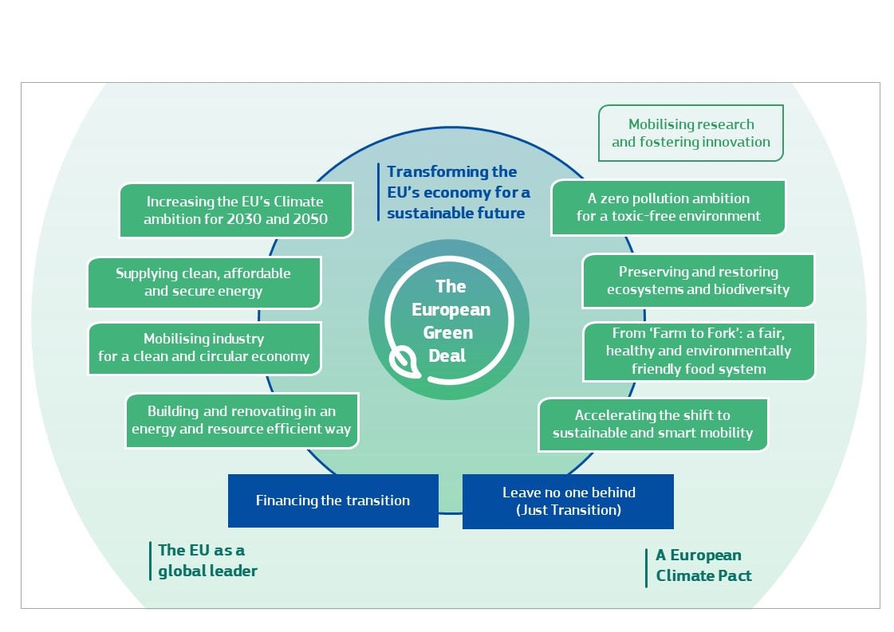
the European Green Deal – eleven initiatives or a systemic transformation?

Slide 4
Translating the system change compass to systemic orientations
System Change Compass
(10 Principles)
Application to the system to derive systemic orientations
Overarching System
30 System-level orientations
Economic Ecosystem
3-5 Ecosystem-
level orientations
Champions
50+ Champion orientations

Slide 5
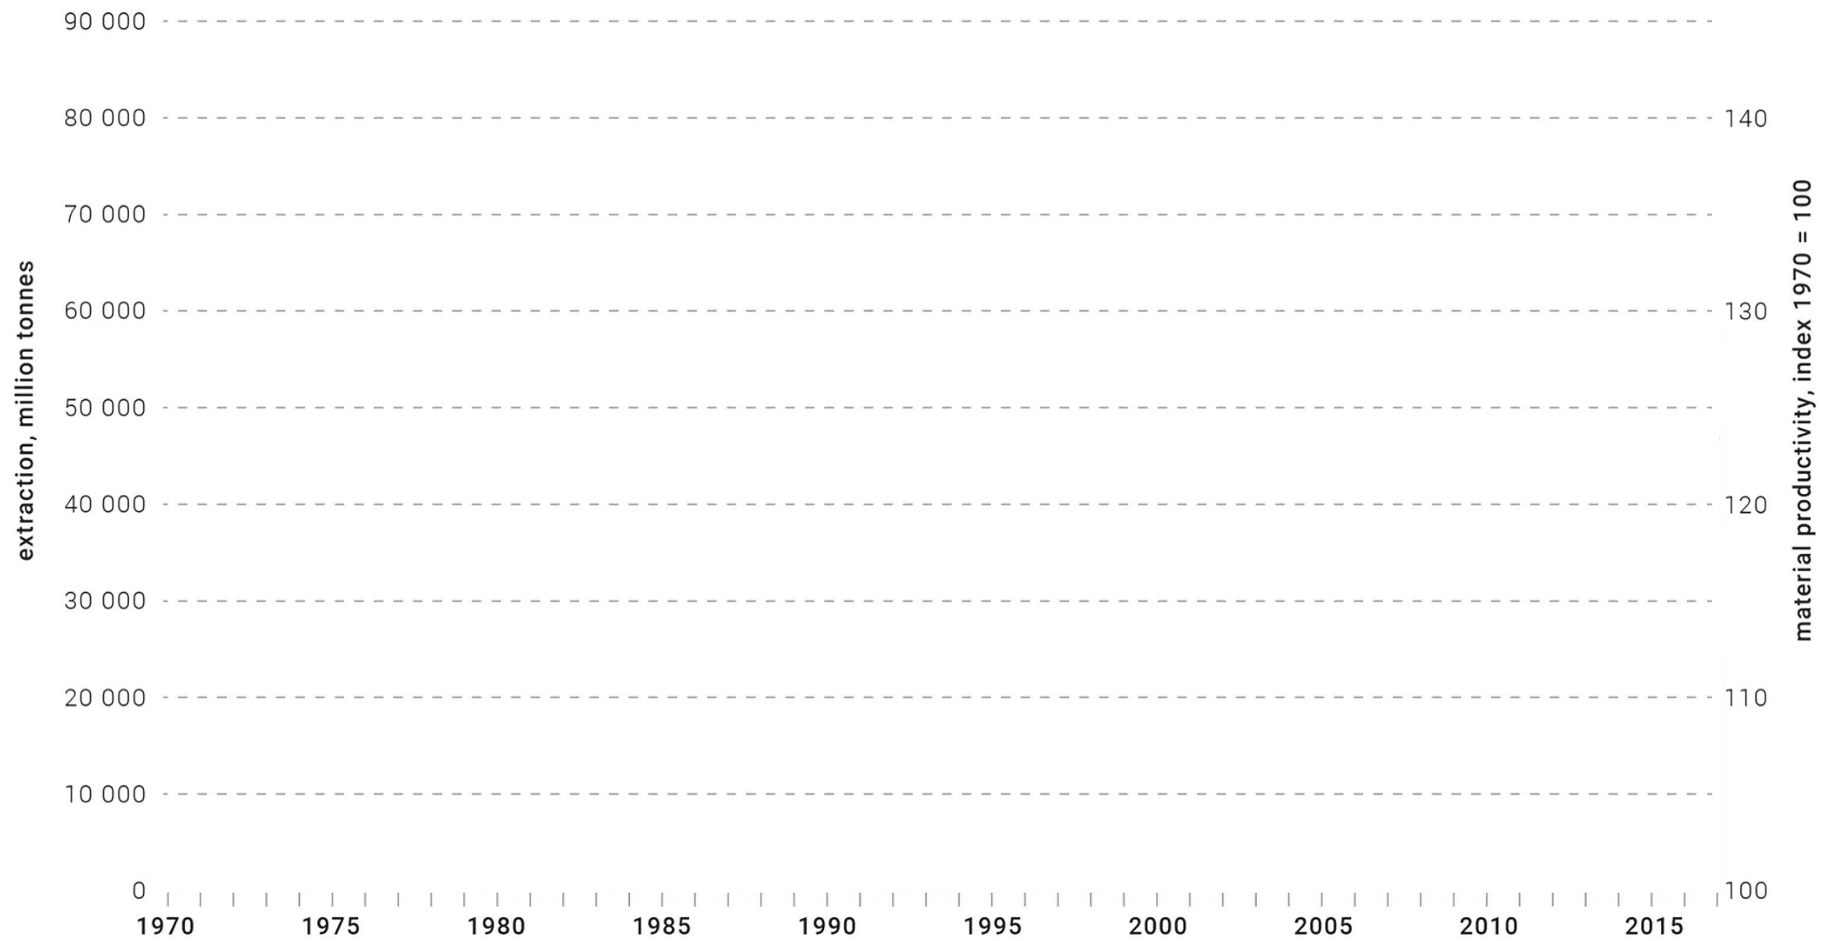
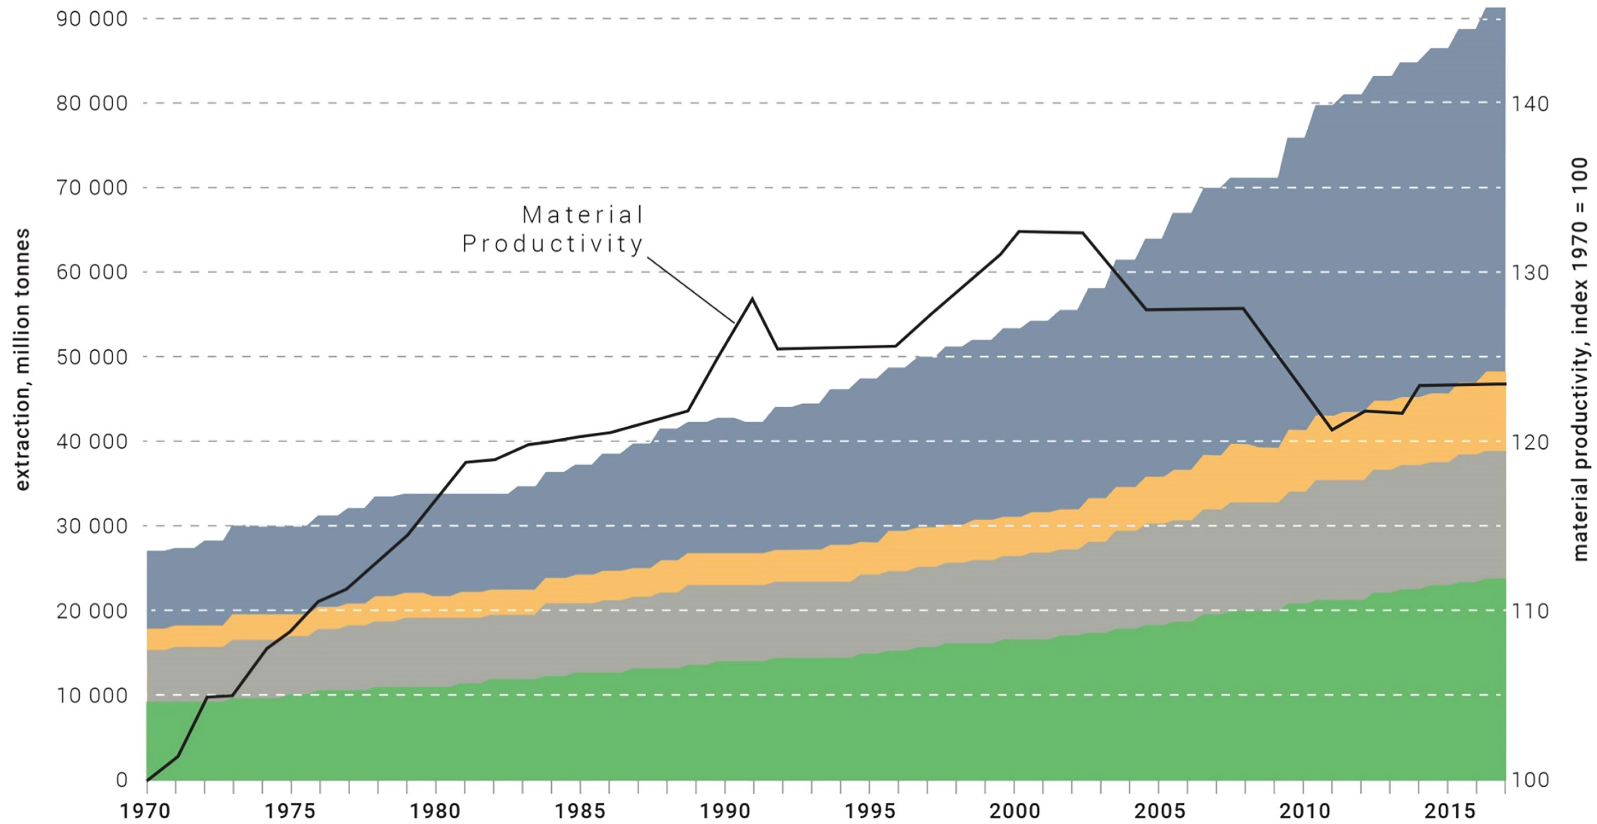
Global resource productivity is declining - our system is wasteful
Worldwide resource extraction and resource productivity, 1970-2017
Source: Global Footprint Network, 2012; UNDP, 2014a; Global Resources Outlook 2019, IRP
Biomass
Metals
Fossil fuels
Minerals (non metallic)

Slide 6
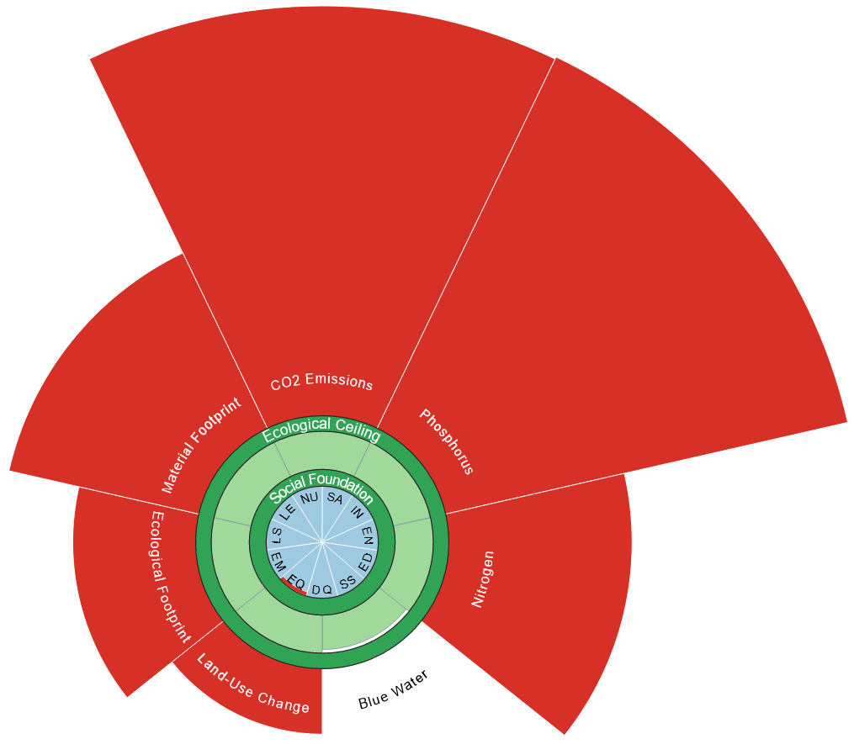
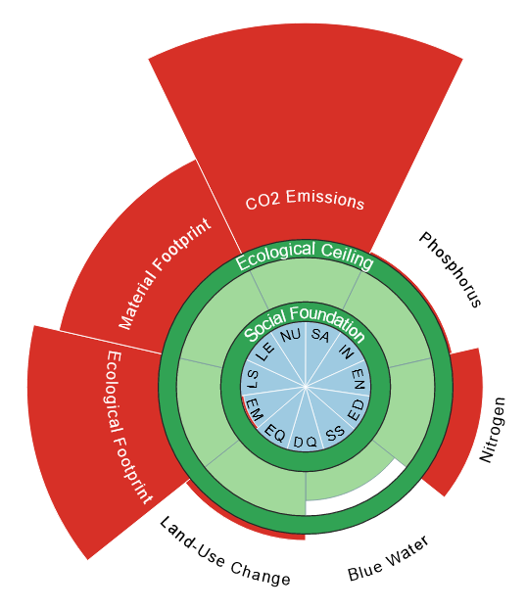
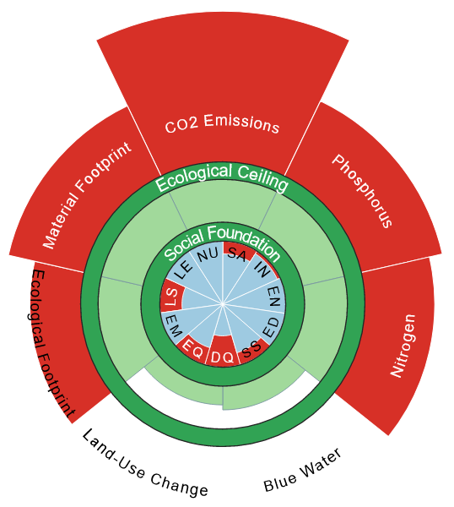
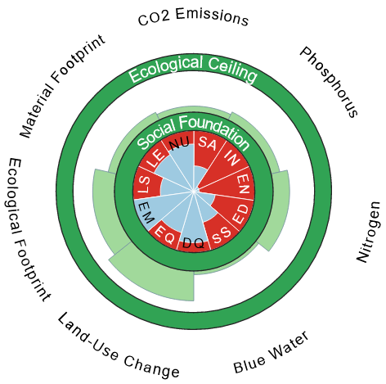
the rich countries are massively overstepping planetary boundaries
Source: Doughnut Economics Action Lab,
University of Leeds (goodlife.leeds.ac.uk)
Malawi
$1,000 pc
China
$17,200 pc
Belgium
$54,000 pc
Australia
$54,900 pc

Slide 7
rich countries are massively overstepping planetary boundaries
Source: Doughnut Economics Action Lab,
University of Leeds (goodlife.leeds.ac.uk)
Malawi
$1,000 pc
China
$17,200 pc
Belgium
$54,000 pc
Australia
$54,900 pc

Slide 8
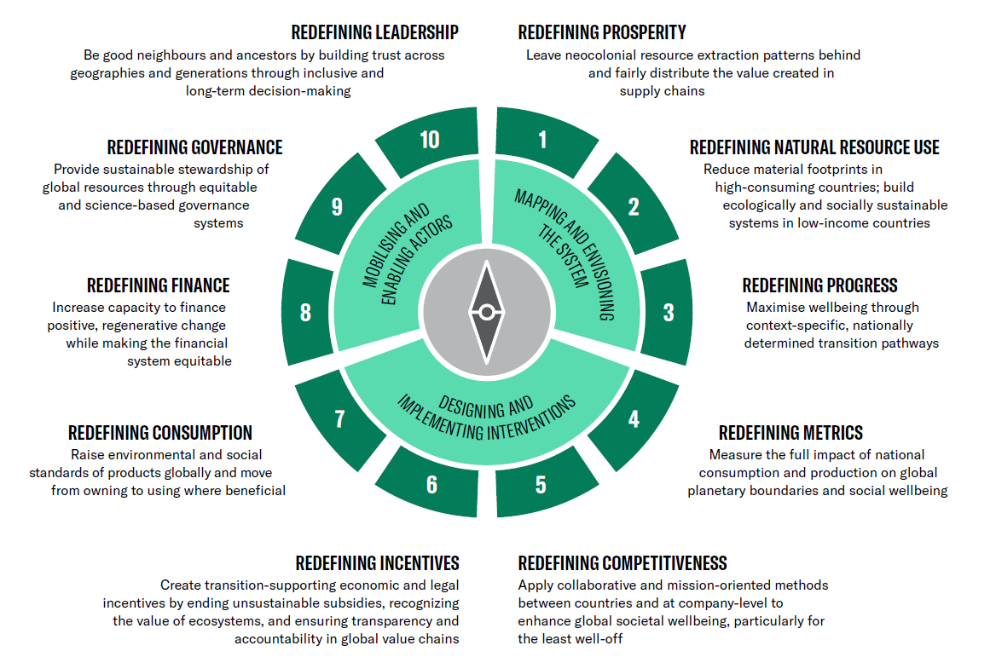
The international system change compass

Slide 9
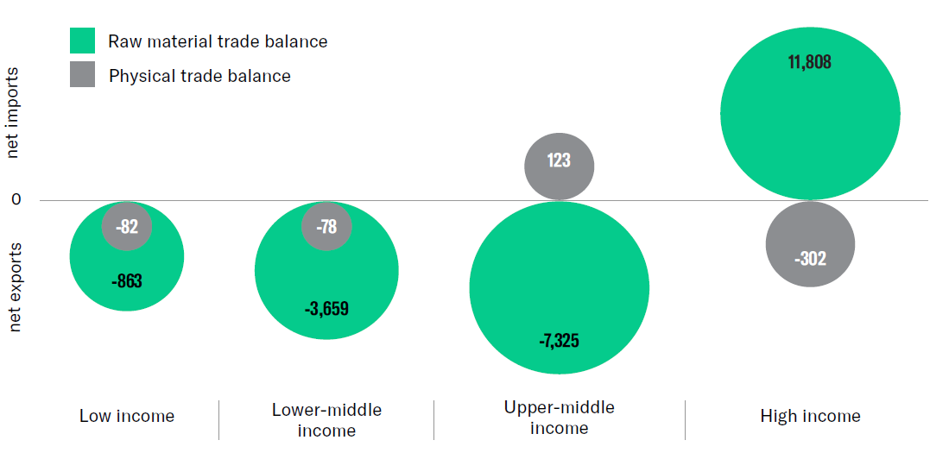
A (Neo)colonial model: The rich world is fuelled by raw materials from elsewhere on the planet
Source: International Resource Panel (2019), Global Resources Outlook 2019 Summary for Policy Makers
11,808
123
-82
-78
-302
-863
-3,659
-7,325

Slide 10
THE DEMAND SIDE
Greening the supply side will not be enough to meet EGD targets.
Europe must address the inherent wastefulness of our production and consumption. Pointless to decarbonize steel production, if it is used to produce under-used cars and houses.
Demand-side measures get closer to addressing responsibility and equity.

Slide 11
Some practical pointers for policy makers:
What the (International) System Change Compass advocates
Redefining consumption from owning to using
Redefining production from mass sales to providing efficient functionalities
Redefining core economic incentives such as taxation, subsidies, and public procurement
Integrating well-being as the objective across all policies
Measuring sustainability across the life-cycle and across policy areas
Activating financial potential to enable transition
Encourage innovation in categories of economic ecosystems that provide societal functions, rather than in categories of production sectors

